Slide 1
Distribution Network of Craft Beer for a Start-up

Slide 2
Introduction
Our client is a startup craft beer brewer, they look for a distribution network of their craft beer in one of the area in Toronto. Since the supply of craft beer is limited, they would like to find out the most suitable area to maximize their profit.
Challenge:
limited supply and “best tasting period“
high target selling price (i.e. 60% more expensive than branded beers e.g. Heineken, Budweiser),
special flavour like herbs, sours, salty lemon, etc. (Asian flavour)

Slide 3
Requirement from client
look for an area with lots of bar/pubs/restaurants
Area with Asian restaurants is preferred (client think that it would be an advantage if people has exposure on Asian culture)
people are willing and affordable to spend money on the beers. (pricey restaurants)

Slide 4
Data acquisition and cleaning
Data Source:
FourSquare developer API
https://en.wikipedia.org/wiki/List_of_postal_codes_of_Canada:_M (List of postal codes of Canada)
http://cocl.us/Geospatial_data (Latitude and Longitude data)
Workflow:
Extract the list of postal codes of Canada and incorporate latitude and longitude from URL
Get the Nearby Venue info via FourSquare API
Filter out desired Venue
Get the Venue detail and analyze the data

Slide 5
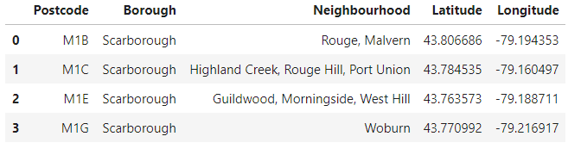
Areas around Toronto and its latitude and longitude
103 records are generated

Slide 6
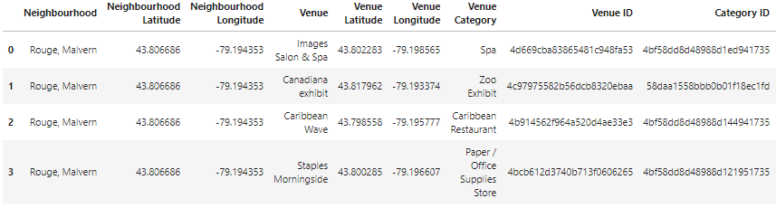
Nearby Venues in Areas around Toronto
6833 records of Nearby Venues
Including Venue Category, Venue ID and Category ID for further analysis

Slide 7
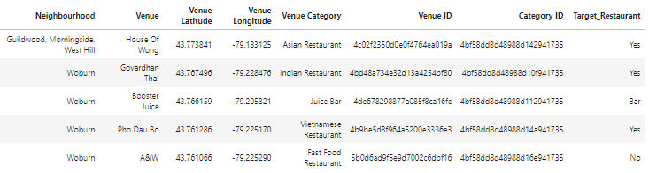
Venue details of Restaurant and Bar
Only Venues contain "Restaurant, Diner, Bar, Beer, Pub, Brewery, Lounge“ are selected
3706 records of targeted Venues
Column of ‘Target_Retaurant” created to indicate Asian restaurant (“YES”), Other restaurant (“No”), and Bar
Venue Category, Venue ID and Category ID for further analysis

Slide 8
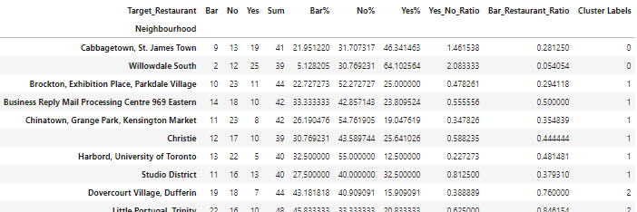
K-Mean Clustering
Group by “Neighbourhood” and calculate number of Bar, Asian restaurant and Other restaurant .
Use K-Means Clustering to Categorize the areas (k = 4)
Select cluster with best “Bar to restaurant Ratio” and “Asian to other restaurant Ratio”

Slide 9
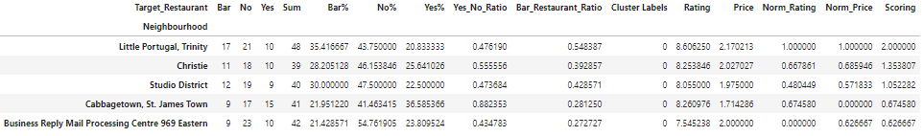
Scoring on selected areas (resut)
Search via FourSquare API and calculate the mean of “Rating” and “Price” of each selected area
Normalized the mean of “Rating” and “Price”
Norm_Rating + Norm_Price as scoring
Result: Little Portugal, Trinity to be the most suitable area (i.e. proper bar and restaurant ratio, highest Rating and pricey index)

Slide 10
Conclusion
By using geographical data and Venue details via Foursquare API, a set of data is formed for analysis
Identify targeted Venues to narrow down the area of study
Extracted necessary information via Foursquare for scoring (i.e. Rating and price index)
Little Portugal, Trinity to be the most suitable area
Many Bar and restaurant in this area ← larger market, people are willing to spend
High ratio of Asian restaurant ← higher chance that people accept the special flavour of craft beer
high “price” and “Rating” index in average ← pricey restaurant indicate that people are willing to spend money on bar / restaurant, and probably on the pricey craft beer
For deeper analysis, we could further study the venue details from foursquare (e.g. menu, comment)

